Slide 1

INFOB2DA | Practical Assignment 1
Data understanding and preprocessing
Jack, Felicia and Joost

Slide 2
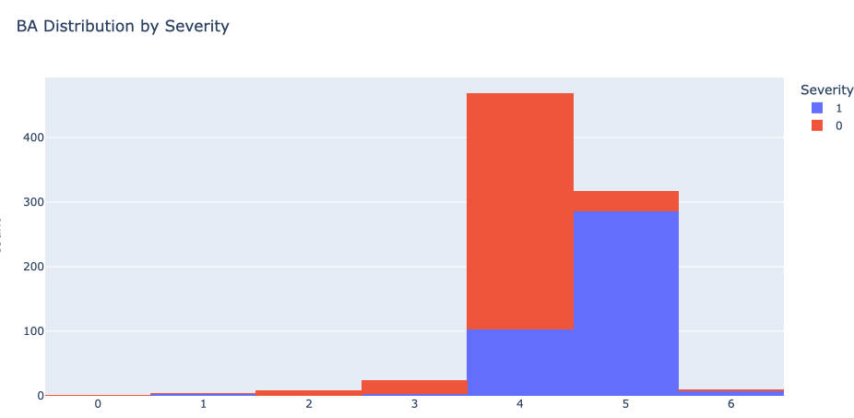
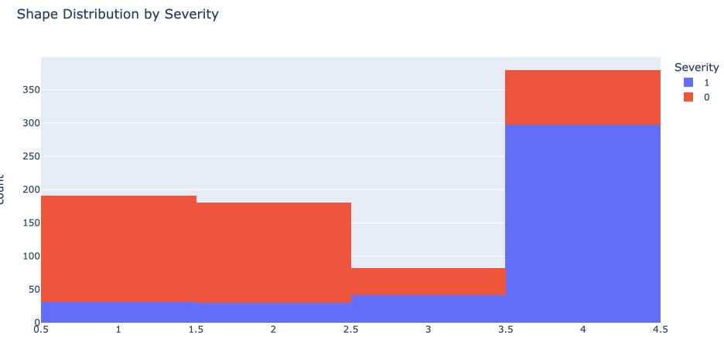
Overview Dataset
BA Age Shape Margin Density Severity
count 959.000000 956.000000 930.000000 913.000000 885.000000 961.000000
mean 4.300313 55.487448 2.721505 2.796276 2.910734 0.463059
std 0.683469 14.480131 1.242792 1.566546 0.380444 0.498893
min 0.000000 18.000000 1.000000 1.000000 1.000000 0.000000
25% 4.000000 45.000000 2.000000 1.000000 3.000000 0.000000
50% 4.000000 57.000000 3.000000 3.000000 3.000000 0.000000
75% 5.000000 66.000000 4.000000 4.000000 3.000000 1.000000
max 6.000000 96.000000 4.000000 5.000000 4.000000 1.000000

Slide 3
Visualization Data cleaning procedure
Why Reasons for the
Presentation
Confirmatory Analysis
Exploratory Analysis
Ignore the tuple
+ easy
- loss of information

Slide 4

Data Preprocessing
High quality and reliable data
Enhancing model interpretability
Smooth out noise
.
.
.
Why?
Notes:
F

Slide 5
Data Preprocessing
We took three steps to do data preprocessing
Data cleaning
Normalization
Data reduction
Notes:
F

Slide 6
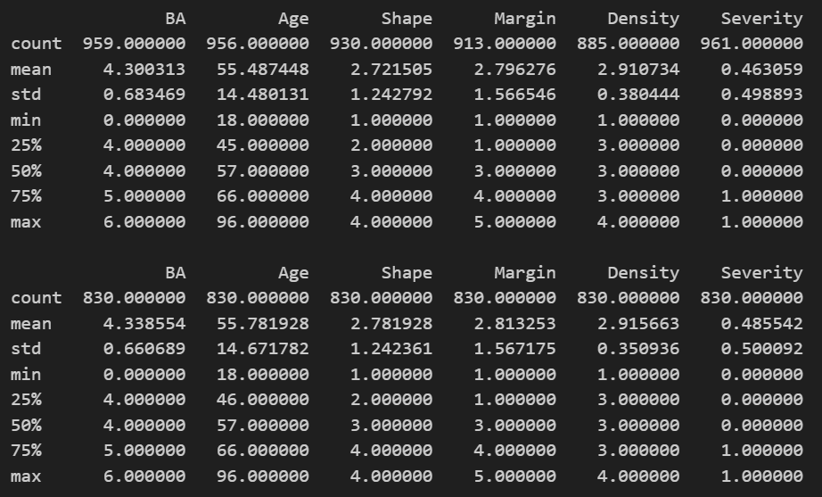
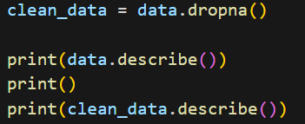
Data Cleaning
Same size, more adequate mean and standard

Slide 7
Normalization
We do normalize for…
Scaling features
Mitigating numerical instabilities
Easier to visualize
Notes:
Scaling Features: Normalization scales features (variables) to a standard range, typically between 0 and 1. This ensures that all features have a similar scale, preventing certain features from dominating the modeling process solely because they have larger values.
Mitigating Numerical Instabilities: In machine learning algorithms that are sensitive to the scale of features (e.g., gradient descent optimization algorithms), large variations in feature magnitudes can lead to numerical instability. Normalization helps stabilize these algorithms by keeping features within a consistent range.
Visualizations: Normalized data is often easier to visualize because it eliminates the issue of one feature dominating the plot due to its larger scale.

Slide 8
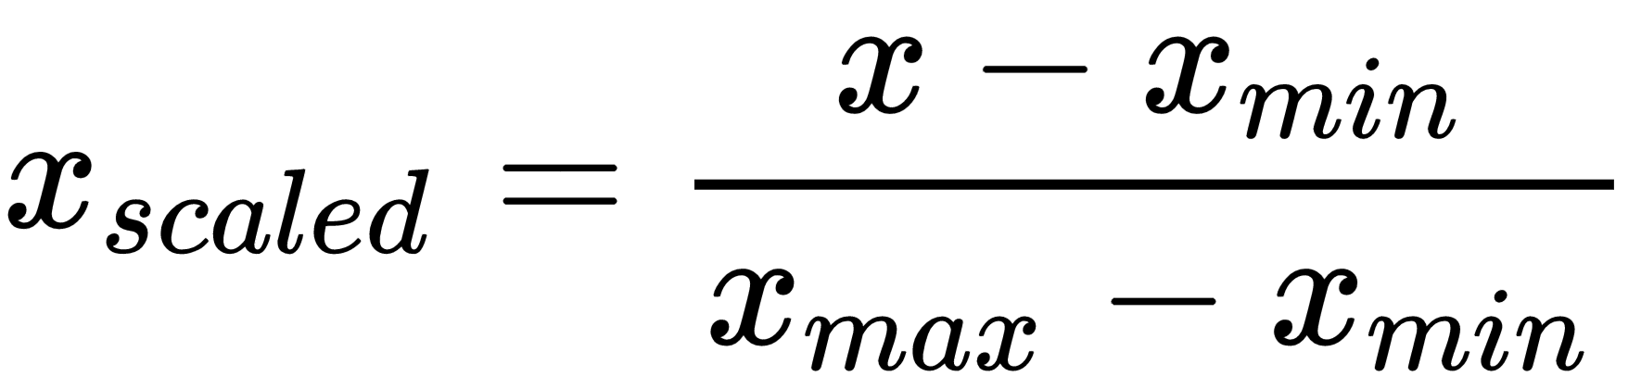
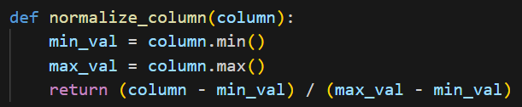
Normalization method we applied
Min-max normalization
Notes:
F

Slide 9
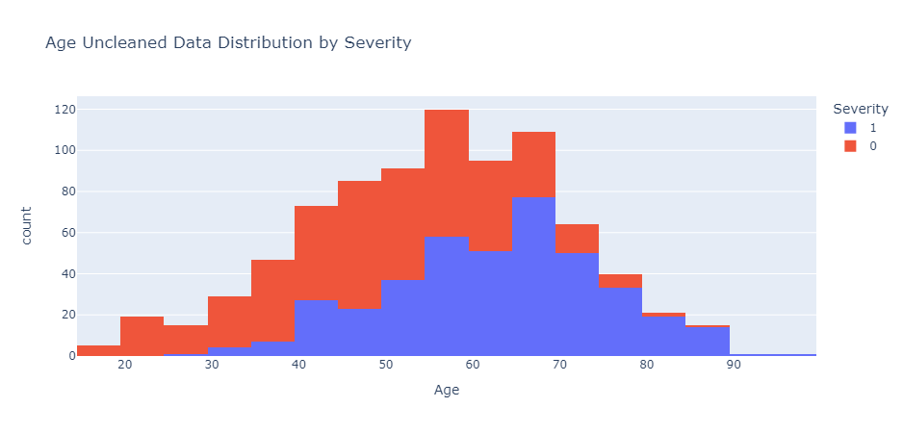
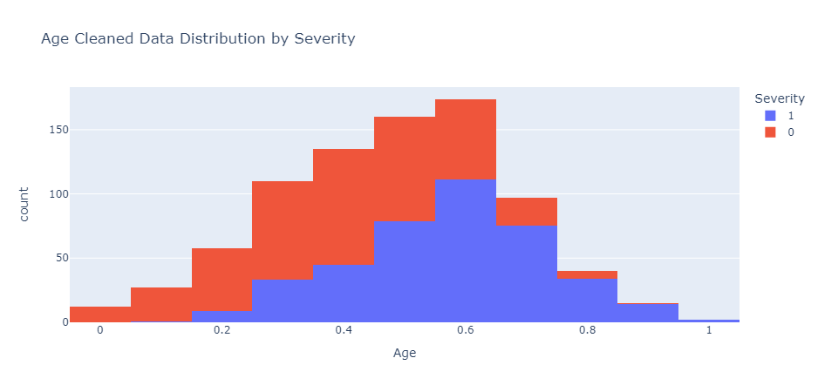
Normalization method we applied
Min-max normalization on the variable-age
Notes:
F

Slide 10
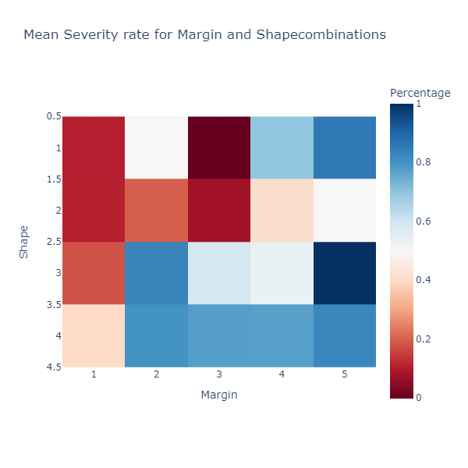
Feature Reduction
ANOVA F-value, similar to statistical significance
Comparies variation between the group means to the variation within each group
Determine random chance or genuine correlation
Reduce features to reduce processing overhead
Best features, not necessarily good features

Slide 11
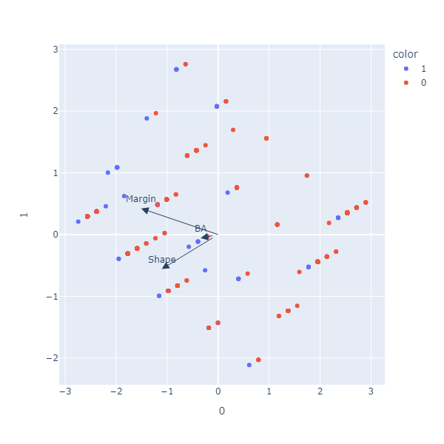
PCA & tSVD
Dimensionality reduction techniques
PCA: Reduces the number of features in data while preserving important information.
PCA: It finds new axes (principal components) where the data varies the most.
PCA: Projects data onto these new axes.

Slide 12
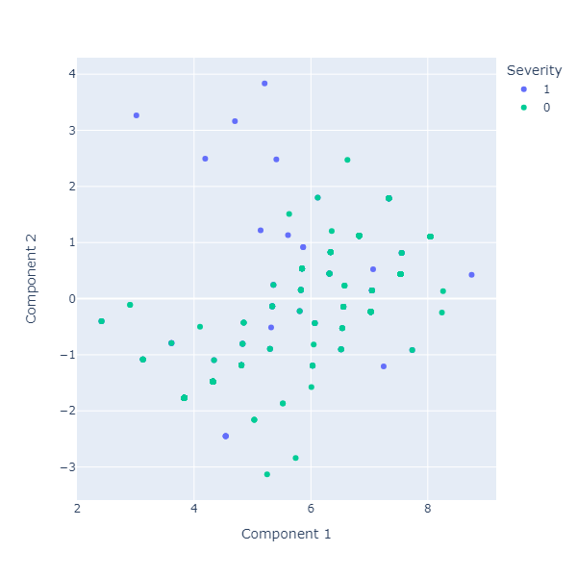
PCA & tSVD
tSVD: Decomposes data into a few important components.
tSVD: Factorizes the data matrix directly into components.
tSVD: Keeps only the most significant ones.
PCA finds orthogonal components based on data's covariance.
TSVD directly decomposes data matrix, not necessarily orthogonal.
Choose PCA for variance preservation and orthogonality.
Choose TSVD for direct decomposition and simplicity.

Slide 13
Conclusion
Margin & Shape most correlated features
Usefulness of extra features drops off immensely afterwards
No immediately noticeable clustering of the Severity feature ->
Prediction of the severity is very unlikely going to be very deterministic
We can however the trend between these three features

